Slide 1
Contributing factors to win a superbowl

Slide 2
Financial
Big market vs small market
Proximity of salary cap
Average player salary
Average team salaries
Geographic impact
Travel distances
Injuries Domes vs outdoor
Score changes dome vs outdoor
Offensive stats
Completion %
Rushing yards
Defensive stats
# sacks
# icps

Slide 3
Last 10 season Statistics on winner and loser of Superbowl
Final scores
Season record for win loss percentages
Total points accrued throughout the season for Superbowl winner and loser

Slide 4
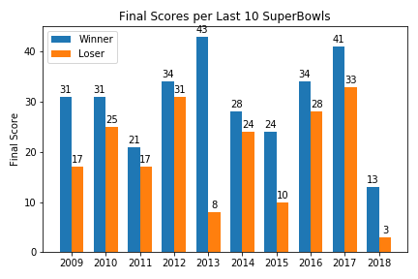
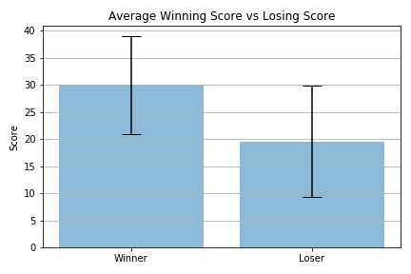
Final Scores!

Slide 5
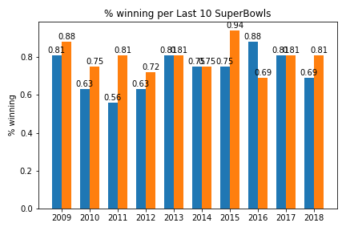
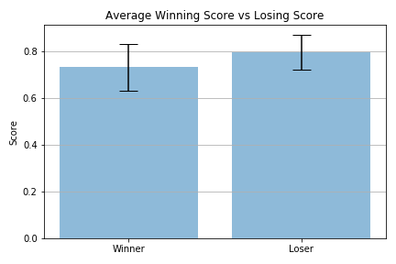
Season win loss record
Advantage Loser

Slide 6
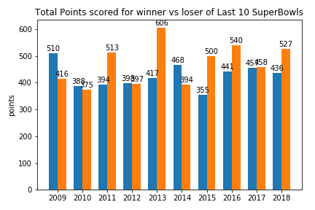
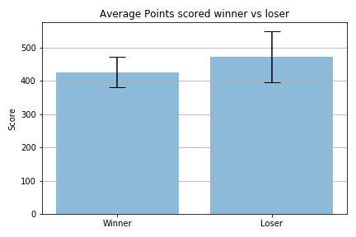
Total Points scored throughout the season before the superbowl
Advantage Loser

Slide 7
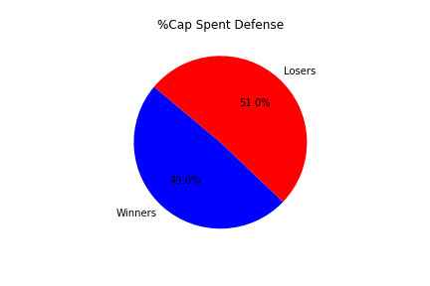
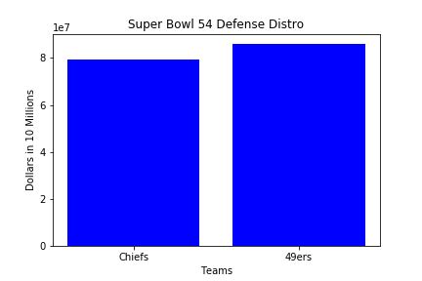
Defensive spending comparison
Advantage Chiefs

Slide 8
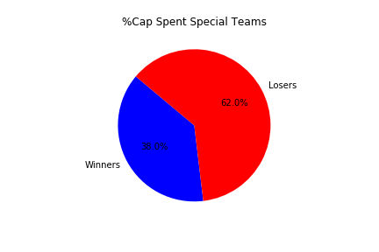
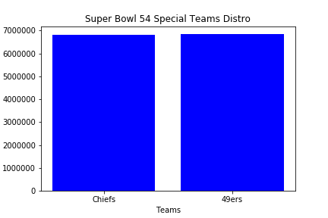
Last 10 season Statistics
Advantage None

